Slide 1




Lifemapper Server
Virtualization
Aimee Stewart (KU) astewart@ku.edu
Nadya Williams (UCSD) nadya@sdsc.edu

Slide 2
… Is Way Harder Than
We Thought
Notes:
This session is called Demo/Innovation -
We chose to do an “Innovation” presentation, instead of a demo

Slide 3

Lifemapper
Data library
Climate
Observed
IPCC Predicted Future Climate
Species
Occurrence Points
Potential habitat maps
Tools
LmSDM: Species Distribution Modeling
LmRAD: Range and Diversity
GBIF
Notes:
First, I’d like to give you a brief background on what Lifemapper is
Lifemapper is a software project at the University of Kansas Biodiversity Institute.
It has 2 core functions: Providing data and research tools through web services.
The data consists of
climate data plus
globally distributed species occurrence data, aggregated by the Global Biodiversity Information Facility (GBIF)
From these data Lifemapper calculates potential species distribution maps.
All of these input and output data can be downloaded using web services or viewed on our website
They are also easily accessed programmatically
The research tools include two modules,
Species Distribution Modeling, or LmSDM, for mapping the potential distribution of individual species and
Range and Diversity, or LmRAD, for looking at landscape level ecology with multiple species.
All of the tools in these modules are available through web services and we provide easier access through a
python client for programmers and
Through plug-ins to the open source applications VisTrails (for workflows) and Quantum GIS (for mapping and GIS)

Slide 4

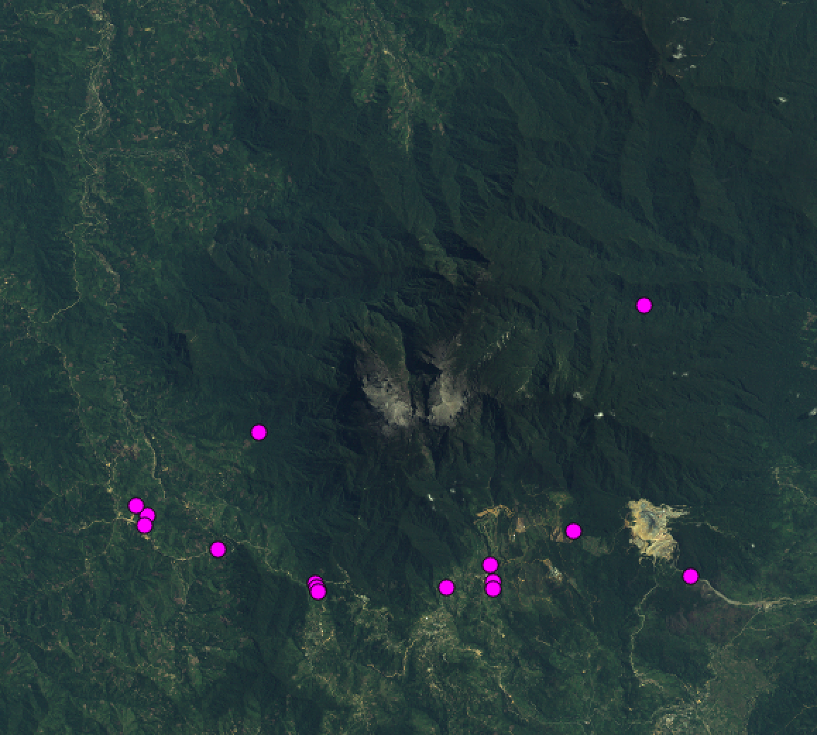


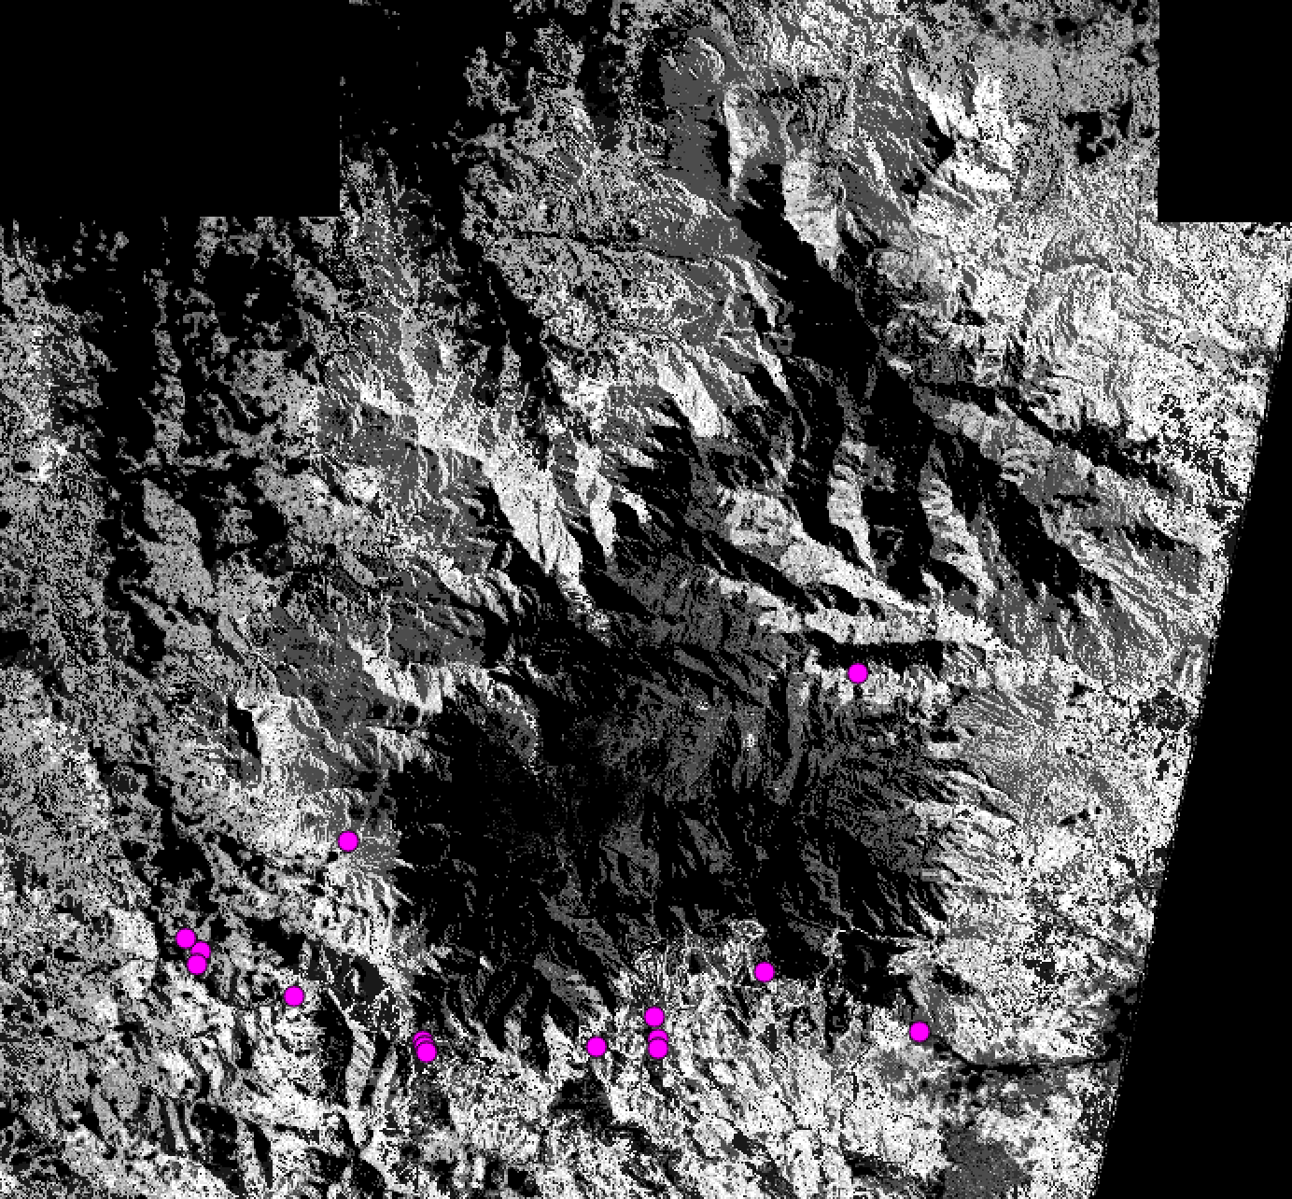
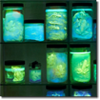



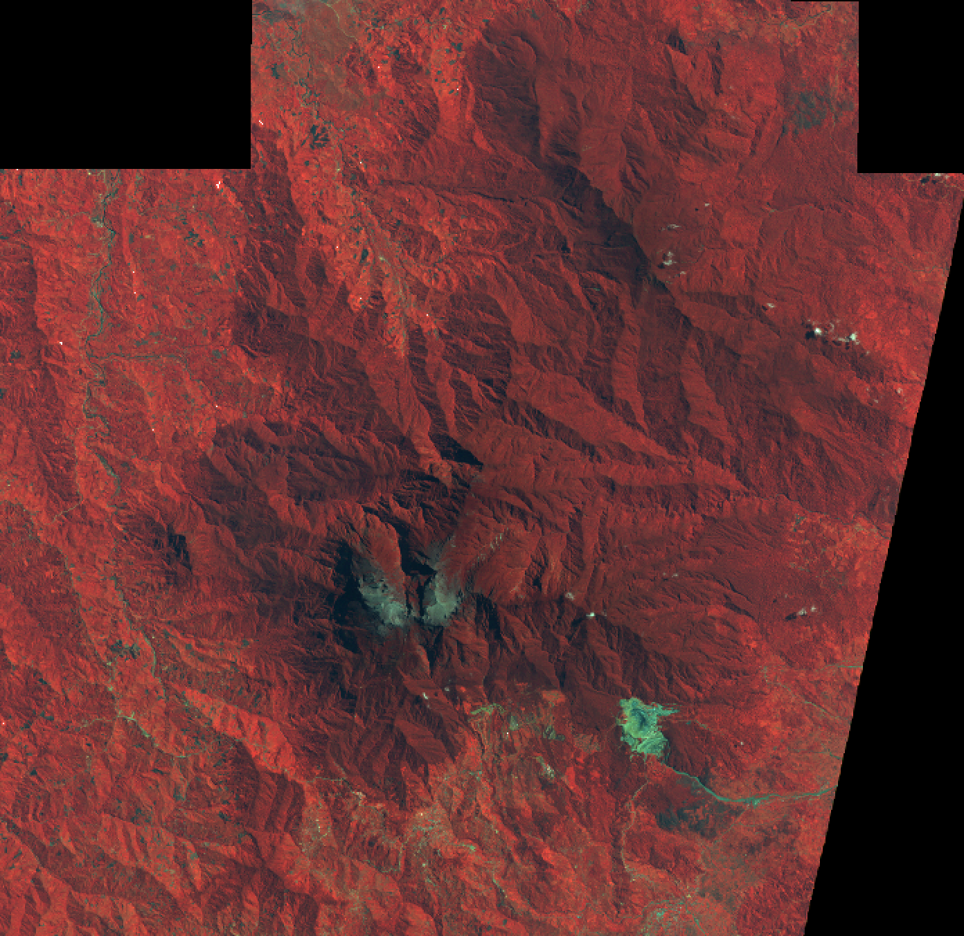
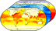
LmSDM: Species Distribution Modeling
Species Occurrence Data
Potential Habitat
Environmental Data
Notes:
For this portion of the VBE, we are using LmSDM, Species Distribution Modeling System. This illustrates the basics of SDM modeling. We input
Species occurrence data, map coordinates of where a species has been found, with
Environmental data for those coordinates.
In our case we are using temperature, precipitation, and elevation data, to create a model of the habitat best suited for the species, based on its known locations.
We use OpenModeller and MaxEnt softwares on our cluster to create these models.
The models are then projected back onto maps of the environmental data to find other areas where the habitat is suitable for the species.
One of the goals of the VBE is to compute these maps for all of Reed/UFL’s species, satellite, and drone data for Mount Kinabalu in Sabah, Malaysia.

Slide 5
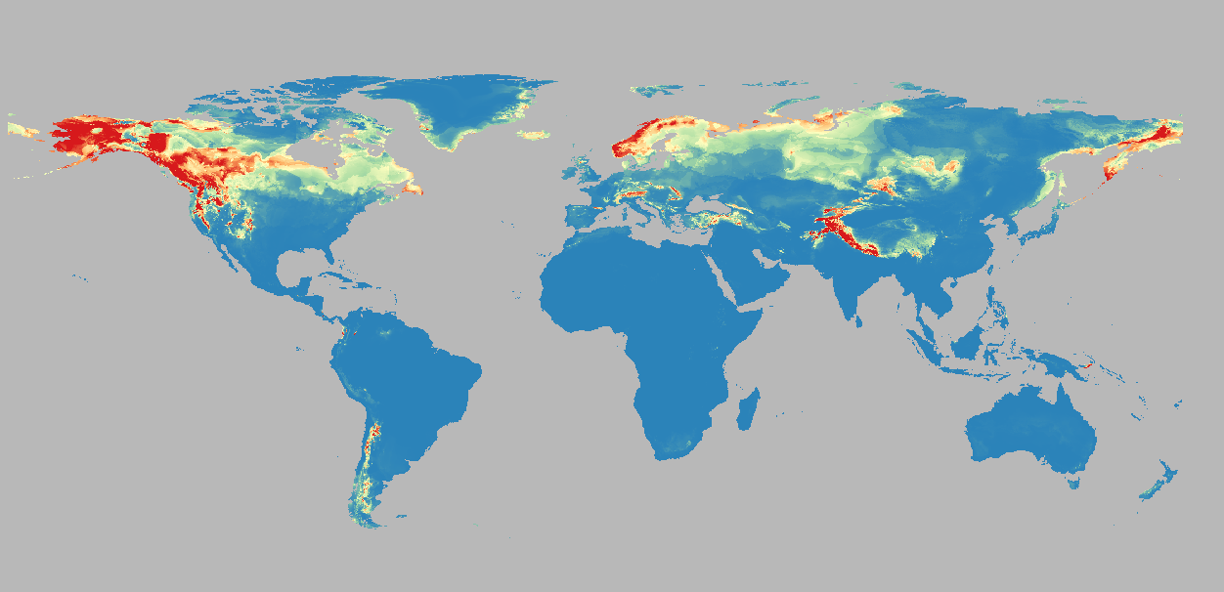
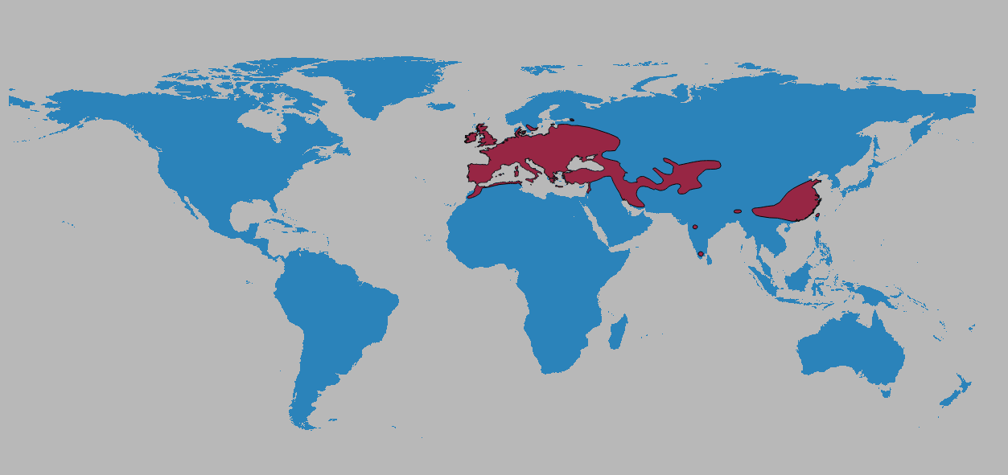
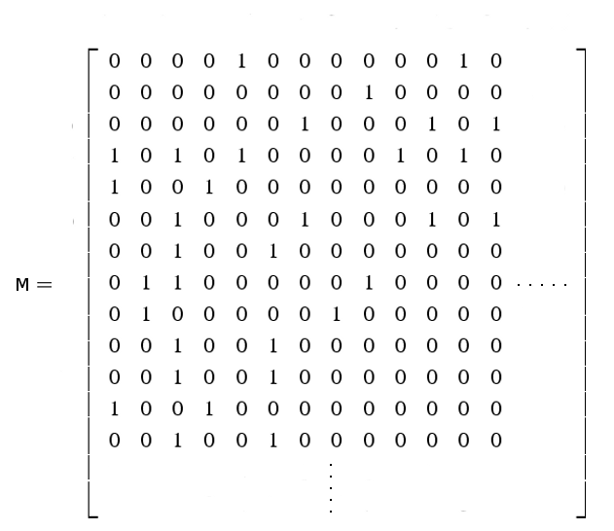
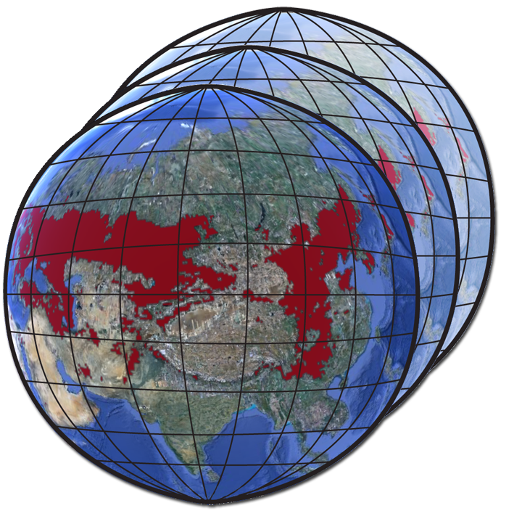
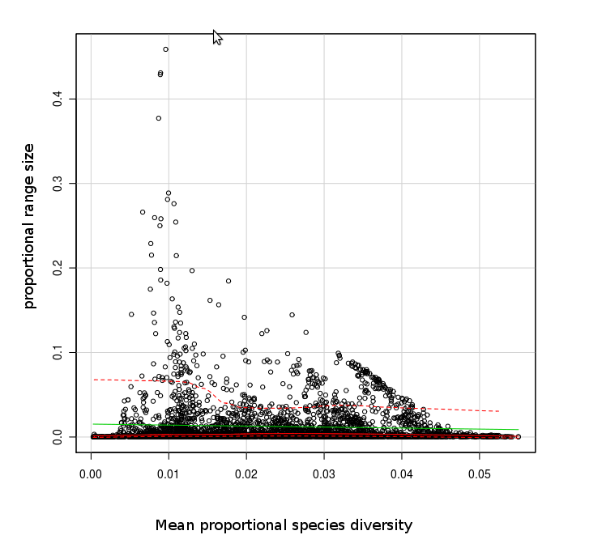
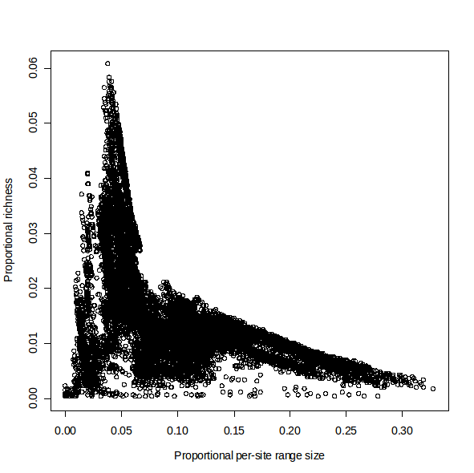
LmRAD: Range and Diversity
Presence Absence Matrix (PAM)
Species Habitat Data
Multi-species analyses
Range and Diversity
Quantifications
Notes:
The second set of tools we are developing are Range and Diversity tools.
We begin with geospatial data, representing species habitat ranges for multiple species
These data are all summarized in a Presence Absence Matrix, or PAM: which then contains much of the information needed to understand species diversity.
From the PAM, we have different ways of representing species diversity, such as scatterplots, indices, and other quantifications
We connect these in an implementation using webservices and client software,
We will support large amounts of data, from multiple sources, and analyze them at multiple scales requiring huge computational resources
Ultimately, we want to combine all the Mount Kinabalu predicted species distributions into a PAM, from which we can compute community-wide, landscape-level, biodiversity indicies for the area.

Slide 6






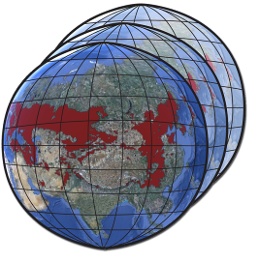
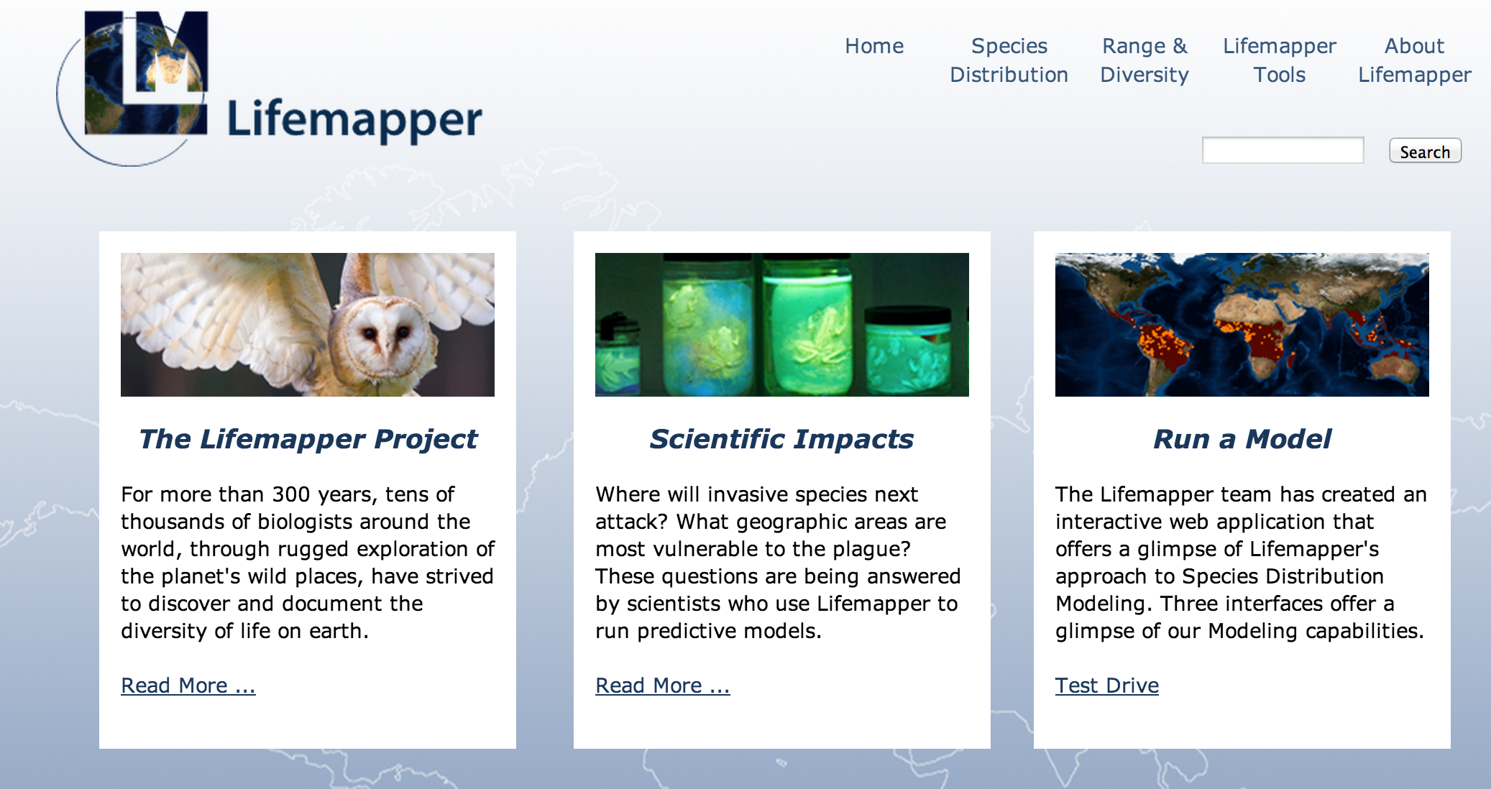
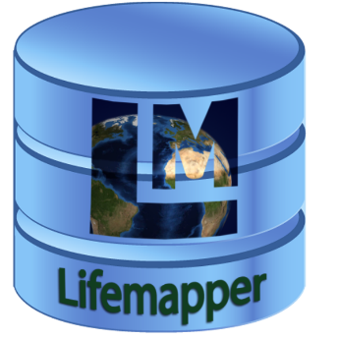
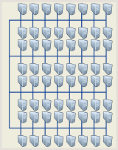
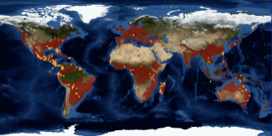
Milestones: Lifemapper refactoring
LmDbServer
LmWebServer
External Clients
Pipeline
Website
REST Web Services
QGIS, Browser, Python Client
Climate
SDSC
LmCompute
Species
LmSDM
LmRAD
Maps & Models
KU
LmCompute
LmSDM
LmRAD
UF
LmCompute
Submit job
Request data
Post result
LmSDM
LmRAD
Visualize, Explore, Analyze
Data updater
Job tracker
Actual/Virtual cluster
Actual/Virtual cluster
Predicted habitat
PAM assembly
Actual/Virtual cluster
Notes:
Another relevant piece of information here is how Lifemapper is designed.
LM is a multi-component system; each component is designed to communicate with the others, but work independently.
The goal is to have multiple instances of one or more components running for individual projects, groups, or anyone else who has a need or finds it convenient to maintain a local piece of the Lifemapper puzzle.
This is also to allow Lifemapper to scale for greater computational and data storage needs.
And it will allow those with data access restrictions to control where their data is deployed.
It also provides a backup or failsafe in case any tier needs maintenance or fails
The components include …
The Data and Management Component
stores all archive input and ouputs, as well as user inputs and outputs
creates jobs for analysis requests by users or the archive and
tracks the status and all parameters of experiments.
The Compute Component
requests jobs from Management and returns them when they are complete.
Compute resources may be optimized for particular data inputs, user jobs, or types of calculations.
The Web Component makes all data and metadata in the Data Component and research tools in the Management Component available through web services.
The Client Component includes the
website and
a python application for programmatic access through user scripts or
a plugin for QGIS – an open-source full-featured Geographic Information System application.
This experiment followed PRAGMA 25 experiment in which we our goal was to separate the components, and deploy LmCompute as a virtual cluster at SDSC
Now we want to decouple the web and db servers from the KU-specific implementation, and deploy them as a virtual machine at SDSC
Our first step was to do a major, but not complete, refactoring of the code base
This simplified our system, and helped remove redundant and unnecessary code from the server components

Slide 7

PRAGMA 26 VBE Goals
PRAGMA 26 Goals: Decouple Lifemapper Server Components from KU
Enable configuration through initialization files
Seed the database with site-specific inputs
Connect the virtualized cluster (PRAGMA 25) to compute jobs
Start the data pipeline to create computational jobs
Issues:
We resolved KU-specific configuration problems
Discovered data-specific bugs, not encountered in fully populated original installation
Some further PRAGMA goals:
Instantiate Lifemapper with Mount Kinabalu data at UF
Customize and extend data workflow through configuration
Notes:
This experiment followed PRAGMA 25 experiment in which we our goal was to separate the components, and deploy LmCompute as a virtual cluster at SDSC
Now we want to decouple the web and db servers from the KU-specific implementation, and deploy them as a virtual machine at SDSC
This also became preliminary or proof-of-concept work for 2 recently submitted proposals concerning scalability with PRAGMA members, UCSD and UFL.
In both cases, having configurable, deployable components will greatly ease testing different solutions
Our first step was to do a major, but not complete, refactoring of the code base
This simplified our system, and helped remove redundant and unnecessary code from the server components
As a team, Nadya and I identified many areas in which the configuration was tied to KU, and she helped us with strategies for parameterizing the setup
We found that not only the code, but much of the data and metadata was not consistent in location, cataloging, creation and updating (pipeline job creation)
We were able to identify most of these inconsistencies and address them in the deployed installation, successfully seeding the database
One or more of these inconsistencies led to the immediate failure of the pipeline, a bug that had not reared its ugly head in our well established, but very specialized, KU installation
So, we were successful in 3 out of the 4 goals for the VBE work this term,
the final goal would have brought everything together and started creating populating species data from GBIF, then computing SDM maps for all these species.
As Phil said, we still have one foot nailed in Kansas – but we are close to completing this final step, and will do that in the next couple of weeks
This illustrates the growth LM functionality has experienced since its latest inception, and the
the complexity of the endeavor

Slide 8
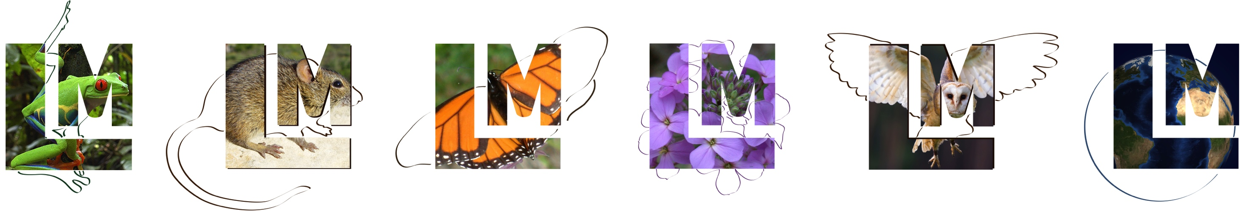

Lifemapper Server Virtualization
Domain scientist’s viewpoint:
Extend previous Lifemapper work to enable data management (LmDBServer) and web services (LmWebServer) components virtualization
Increase the availability and flexibility of Lifemapper to enable scientists to
Assemble multi-species macro-ecology experiments
Perform other LM-facilitated data processing on:
Unique datasets
Restricted use data
Very large datasets
Cyber-infrastructure viewpoint:
Continue practical use of PRAGMA cloud infrastructure
Encapsulate the complexity of software build/configure in ROCKS rolls
Create a complete system as an end-to-end solution
Reduce cost of installing/configuring/replicating

Slide 9
What we are trying to do
Increase availability and flexibility of Lifemapper Server as a complete system
reduce cost of installing/configuring/replicating and ease burden of integrating hardware and software
Enable a fast “workflow” from software update to server availability:
Minimize time spent on software build and configuration
Automate most hands-on tasks.
Essential: have test cases for all installed components and their configuration
Prepare for greater quantity and quality of data and complexity of operations
From low resolution climate data to high resolution satellite imagery for Mt. Kinabalu
From simple single-species SDM experiments to multi-species macro-ecology experiments with more species
This work is a part of PRAGMA’s “Resources and Data” working group
Development
Software update or release
Rebuild the roll
Install test server
Run test server
Bug fixes/upgrades
Production
2
Build production server
1
Lifemapper
http://lifemapper.org
https://github.com/lifemapper/
Rocks
http://www.rocksclusters.org
Pragmagrid GitHub
https://github.com/pragmagrid/lifemapper
https://github.com/pragmagrid/lifemapper-server

Slide 10

Why Automate
Time
Manual hands-on tasks:
Software packages build
Custom scripts
User work-around
Repetitive tedious functions
Tracking errors, exceptions and problems
Automation is no longer nice to have it is a must have that allows to:
Know your system real-time status: what is installed, what version, configuration, data population
Robust system: can reliably build and rebuild
Address complexity of configuring – no more manual settings
What issues need to be documented?
Facilitate easy-to-use solution to provide seamless integration of hw/sw
Allow to virtualize infrastructure to improve hw utilization and scalability
Enable operational efficiency and flexibility: deployment and operation of virtual servers
Enables to clone multiple servers
Time
Time

Slide 11
Milestones: Lifemapper Server Roll
Lifemapper
Postgresql
Postgis
Dependencies
LM code
Pgdg repo
Geos
Proj
Pgbouncer
LM data
Python modules
Mapserver
Elgis repo
Vera fonts
Server
Fribidi
Client
Devel
Contrib
Hdf44/hdf5
Subversion
Cmake
Byacc
Libraries
Openssl
Geos
Mod_python
SpatialIndex
Tiff
Cheetah
Cherrypy
Cython
Psycopg2
Pylucene
Rtree
Gdal
Pgbouncer
Configuration
Postgis
Postgresql
LM components
Total: 56 RPMS
Notes:
Lifemapper Server Roll – create an end-to-end build process to enable an independent instance of Lifemapper data management and web services components. No “manual” work after packages installation: cluster comes up configured
Completely integrated build/install/configure process – automates entire lifecycle of application management and enables:
fast deployment, updates, rollback
provide for VM provisioning: building a virtual host is no different than physical
simplification of packaging and reliable robust deployment
full integration with the underlying cluster

Slide 12
Issues Encountered
Can not make any assumptions about the system
Software refactoring
Differences in dependencies and configuration between Linux flavors: Ubuntu vs. CentOS
Need automation
Software build
Data population
Configuration
Monitoring
Troubleshooting
Need unit tests
Datasets to emulate application’s run-time workflow
For build and post-install stages for installed components and their configuration during the.
Large changes in the build process
What are SW installation defaults and configuration
Application “minimal resources” requirements (i.e. what memory/disk/network/other is needed for application to work) changed with different hardware and data
Scripts for hands-on tasks (previously done only once):
Simplify, harden and streamline code
Notes:
Legacy applications inherently tend to rely on in-home knowledge and previous installs, it is easy to slip into making assumptions (user setup, directory ownerships, etc).
Need to transform existing application management into dynamic, automated, simpler to provision and control.
Automating manual installation and configuration processes, reduces the potential for human error and eliminates legacy processes that can slow down VM provisioning.
The legacy systems are inflexible and unsuited to the dynamic nature of cloud computing because they are:
Complex, often bound to a very specific infrastructure, may be non-standard, fragile (depend on custom scripts)
Assumptions: can not make any about what is installed on the system, what defaults are, how system software is installed and configured. Examples: localization, how python is configured (shared lib) or with what modules
Software installation must be a “build” process and not symlinks to directories checked out from the repository. The build process needs to ensure a reliable installation from scratch and from a know sw distribution version. This way the install process is reproducible. All install locations needs to be configurable, no hard coded paths.
Moving application from physical to virtual host has its own challenges.
Fact 1: Environment is different during build and run time
Fact 2: RPMS brought from outside repos (base, rpmforge, epel) may require an update to the RPMs present on the system. This may not be desirable. Solution:
check if update to RPM is working or breaking the system (openssl – support for secure communication)
may need to create a new RPM with an alternate location (libevent - abstract asynchronous event notification library)
Minimal resources requirements – need to define memory, disk space, queue allocation, etc.
In order to move to virtualization need to address the areas:
packaging (end-to-end as a roll),
distribution (provide upgrade, virtual install)
resource control (allocation of memory, disk to servers and clusters)

Slide 13
Future Work
Data integration – generalize more to use heterogeneous datasets from different sources
Cloud approach – Extend and leverage with PCC and PRAGMA_Boot
Virtualized environment testing
Storage system
Performance estimates
What I/O volume can we handle without degraded performance?
Check for “storage I/O blender effect”
Need to define requirements for
performance
data storage
data management
Need to “translate” application/data requirements when application is moved from physical to virtual servers
Is there a bottleneck?
What is needed for IO-intensive application (database)?
Notes:
Data integration – as a one small step towards the desires to of our Taiwanese colleague
Cloud approach – one way of further generalizing our virtualization and Lm deployment
Extend/leverage with PCC and PRAGMA-Boot
The I/O blender effect is a phenomenon in virtualized environments that degrades storage performance.
The I/O blender effect occurs when multiple virtual machines (VMs) all send their input/output (I/O) streams to a hypervisor for processing. Under heavy work loads, I/O processes which might otherwise have been relatively sequential, become random. This increases the read/write activity on disk heads, which in turn, increases latency. This randomization can occur with all virtualization platforms.
Common methods used to reduce the I/O blender effect include overprovisioning and adding solid-state drives for caching.

Slide 14


Acknowledgements
This work is funded in part by National Science Foundation and NASA grants
PRAGMA
US NSF 1234953
Lifemapper
US NSF EPSCoR 0553722
US NSF EPSCoR 0919443
US NSF EHR/DRL 0918590
US NSF BIO/DBI 0851290
US NSF OCI/CI-TEAM 0753336
US NASA NNX12AF45A
Rocks
US NSF OCI-1032778
US NSF OCI-0721623

Slide 15
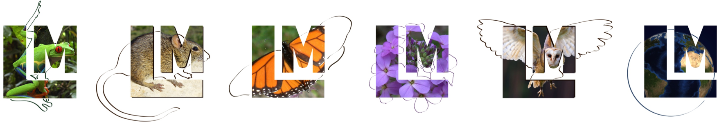
Questions?
Aimee Stewart (KU) astewart@ku.edu
Nadya Williams (UCSD) nadya@sdsc.edu

